Slide 1
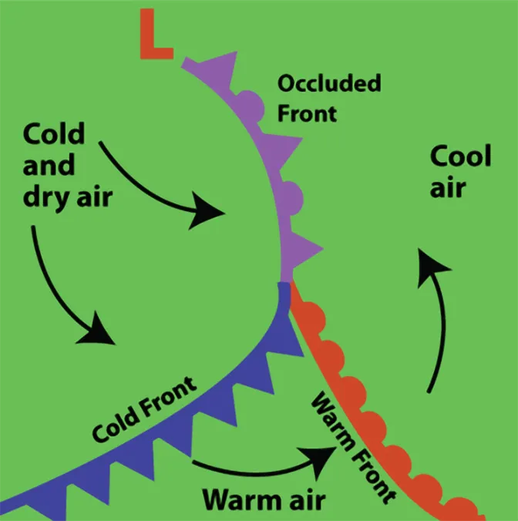
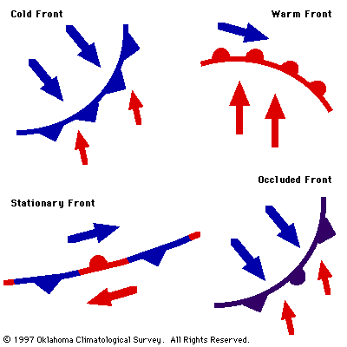
Frontal system prediction using deep neural networks
Pavel Pernička
Notes:
Joke jak sviňa

Slide 2
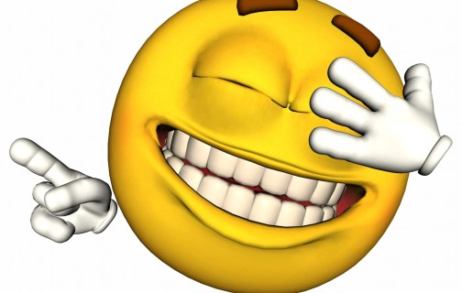
Hehe, just kidding...
Notes:
muhehehehehe

Slide 3
Etiquette how to become the most classy guy in the room
Pavel Pernička
January 2024
Notes:
[Etiketáž]
No one expect
Essential for future life
Businessman
Bilionáři
Better than elon musk
conventional

Slide 4

Etiquette
= French word: label on the table
Expected and accepted social behaviour practised in some social group

Slide 5
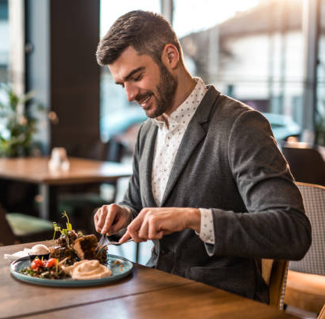
Why is it useful
Improving contact
Annoying noises when eating
Prevention of infection
You're part of a community
Showing respect
Precedence at the door
Showing your better side
Overcoming conflicts
Keeping your distance
Notes:
Zdvořilé chování = polite bahaviour
Precedence = přednost [presidenc]

Slide 6
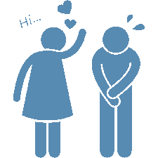


Main topics
Body
Behaviour
Eating
posture and gestures, clothing and hairstyle,
greetings, behaviour towards other people, speech
and conversation rules.
How to eat formally
e.g. in restaurants

Slide 7
Rules!
Notes:
Let’s talk about some rules
In some accasions
Business events
Politics
Ordinary people

Slide 8
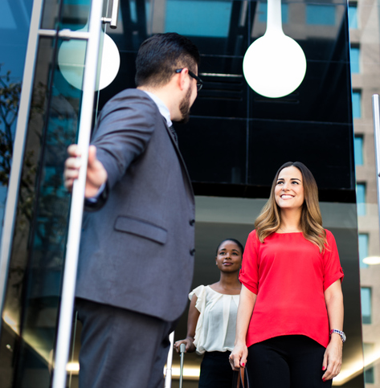
Precedence
Women, older, boss
Superior gives hand first
Woman sits, goes first (except pubs, bars)
women walking on the right side
Stairs – man catches
Notes:
[prezidenc]

Slide 9
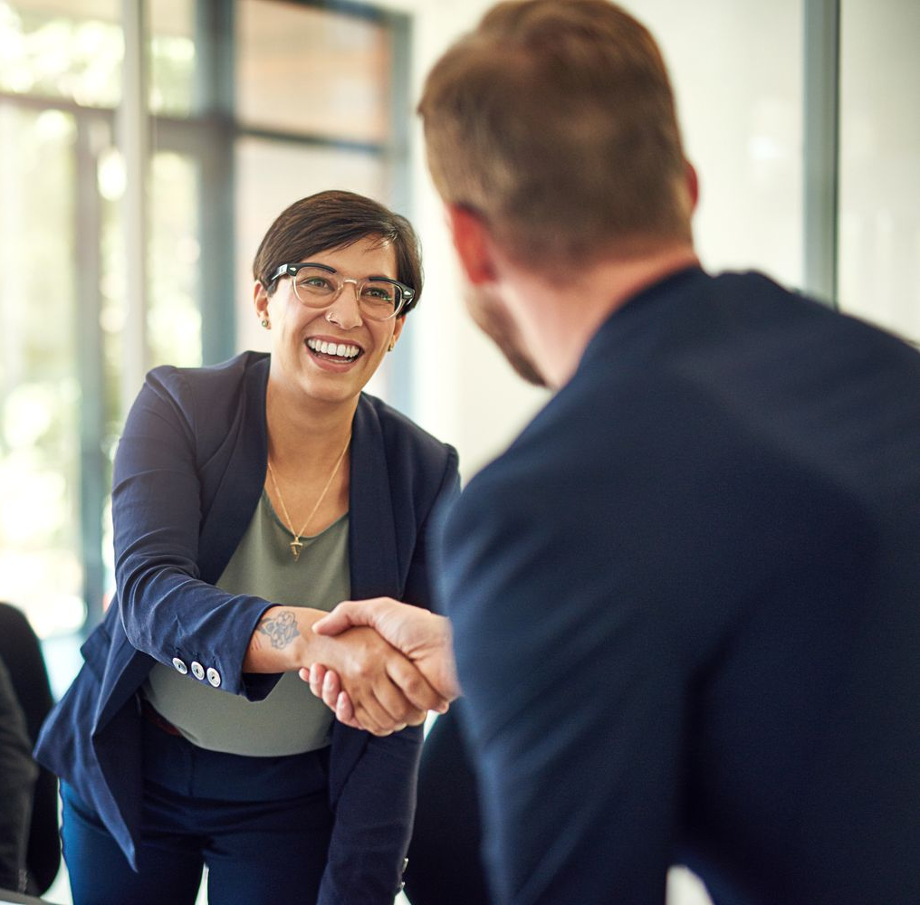
Greeting
No: while sitting (men), across the table, crossing
Hand: not in a glove (women can), dirty
Decent smiling!
Small bow
Max 1 second; right hand
2 pairs: explained
Kissing hands (not actually!)
Notes:
Not holding gun
Tin smile = plecháč
Except scouts – left is closer to hearth
2 pairs:
woman from socially superior pair
Superior woman → inferior woman,
Superior woman → inferior man,
Superior man → inferior woman,
Superior man → inferior man

Slide 10
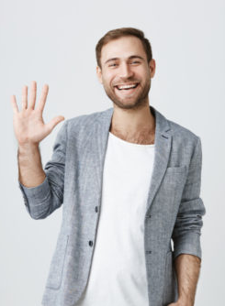
Introducing
Man to woman
Younger to older
Inferior to superior
Not only name; + title, a little info
Difficult name → business card

Slide 11
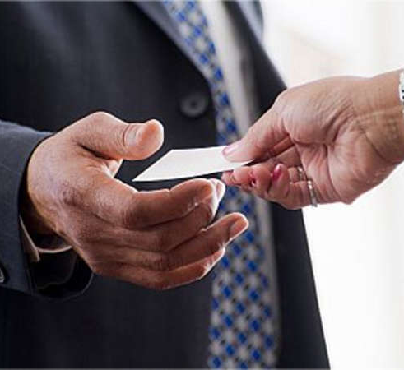
Adressing
Introduced with title → adressed with title
Same with buiness cards
Only the most important title before name
Or higher function (your Majesty, general director...)

Slide 12
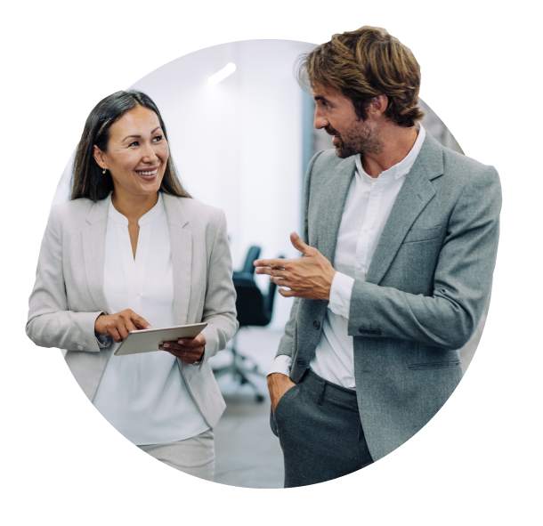
Conversation
Mutual listening
Understandable to both
Not loud
Limit your gestures
don't act superior
Do not open up bitter, controversial, overly technical topics
Ask the quiet person

Slide 13
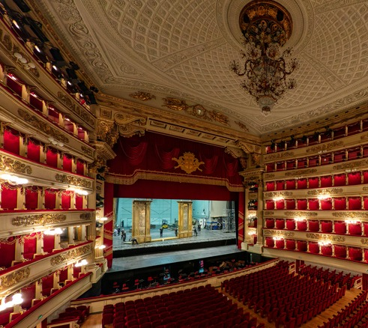
Cinema, theatre
Be prepared – tickets, your place
Know a bit about the film/drama
Finding your seat – head to head
Woman by your right hand (or the better place)
Two couples – women next to each other
Notes:
buy tickets in advance
Man helps woman to get her coat

Slide 14
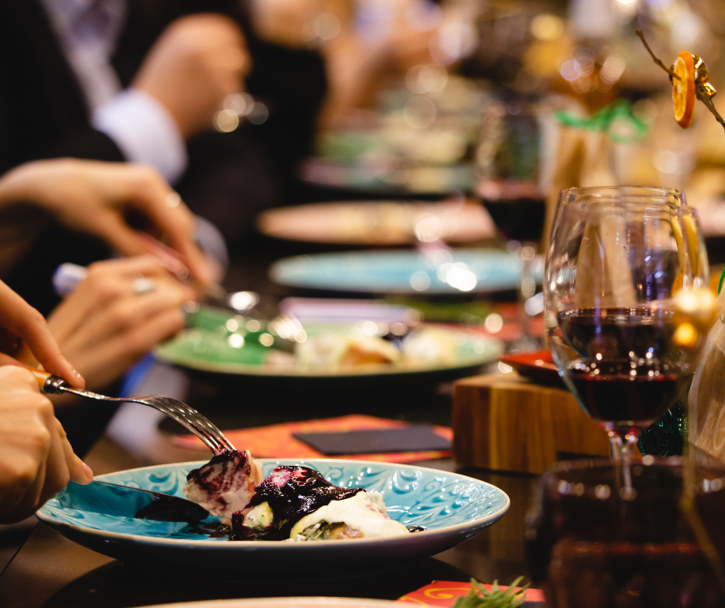
In a restaurant
Men first in, last out (protection)
Don’t worry to ask
Woman starts eating first
Furthest cutlery first
Cressed cutlery = still eating
16:20 = finished
Man pays (woman in business occasions)

Slide 15
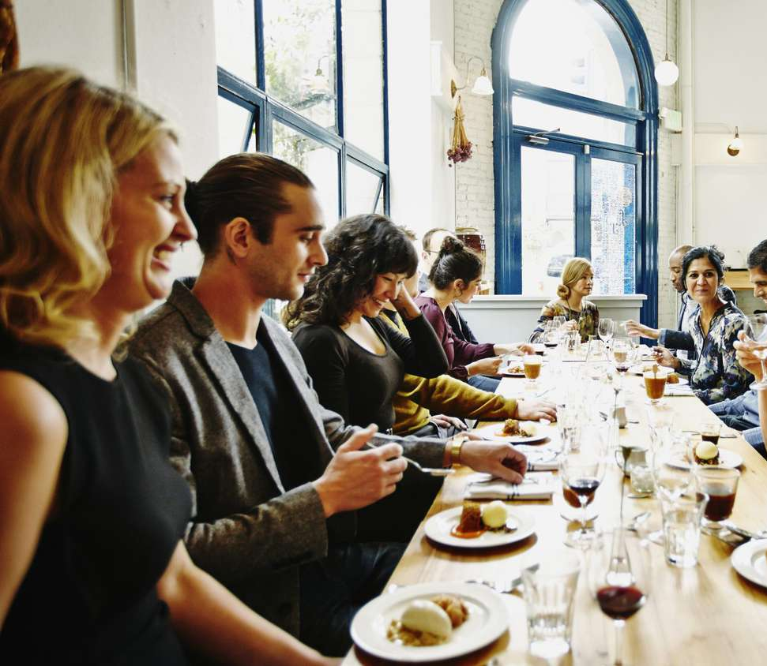
Sitting order
Couples not next to each other
Mixed
Language
Small amount of people - T
Larger group - U
Extra large group – E
Least important furthest from host
Placement map

Slide 16
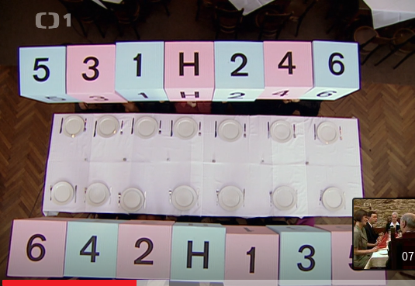

Slide 17
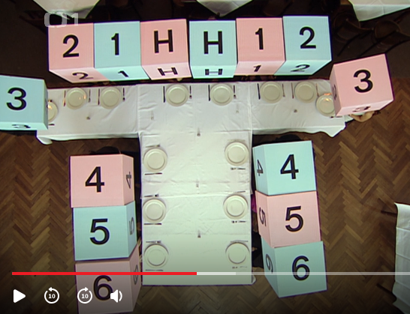

Slide 18
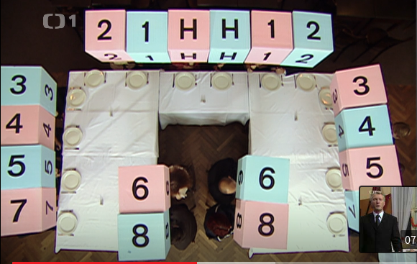

Slide 19
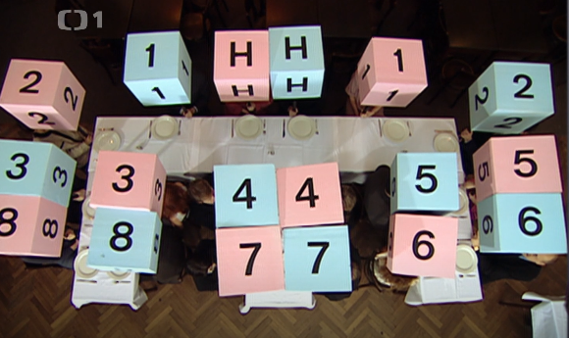

Slide 20
At the table
Bring something to host
Informal: something to eat
Formal: something inedible
Host eats first
Host must come first
Host makes a toast
Bowls: cutlery not into → on the plate
Notes:
Nesundávat jacket jen tak
Přikládací příbor vypouklou stranou nahoru

Slide 21
At the table
Pay attention evenly
Do not stand from a table before host
If you can’t eat dessert – dig it up
Wipe lips before drinking
Don’t drink with full mouth
Don’t lick knife

Slide 22
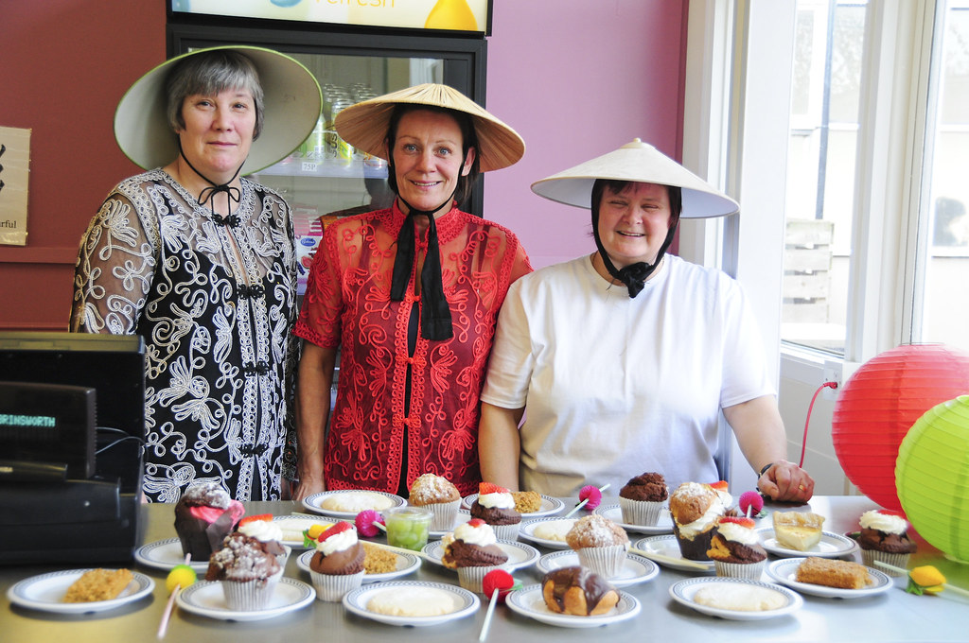
International
Muslims – no pork, no alcohol
Italians – pasta are not main dish
Mexican drinks with salt and lemon
Use spoon and fork for spaghetti
Eat tortilla with hand
Last 1/3 of a soup can be drinked

Slide 23
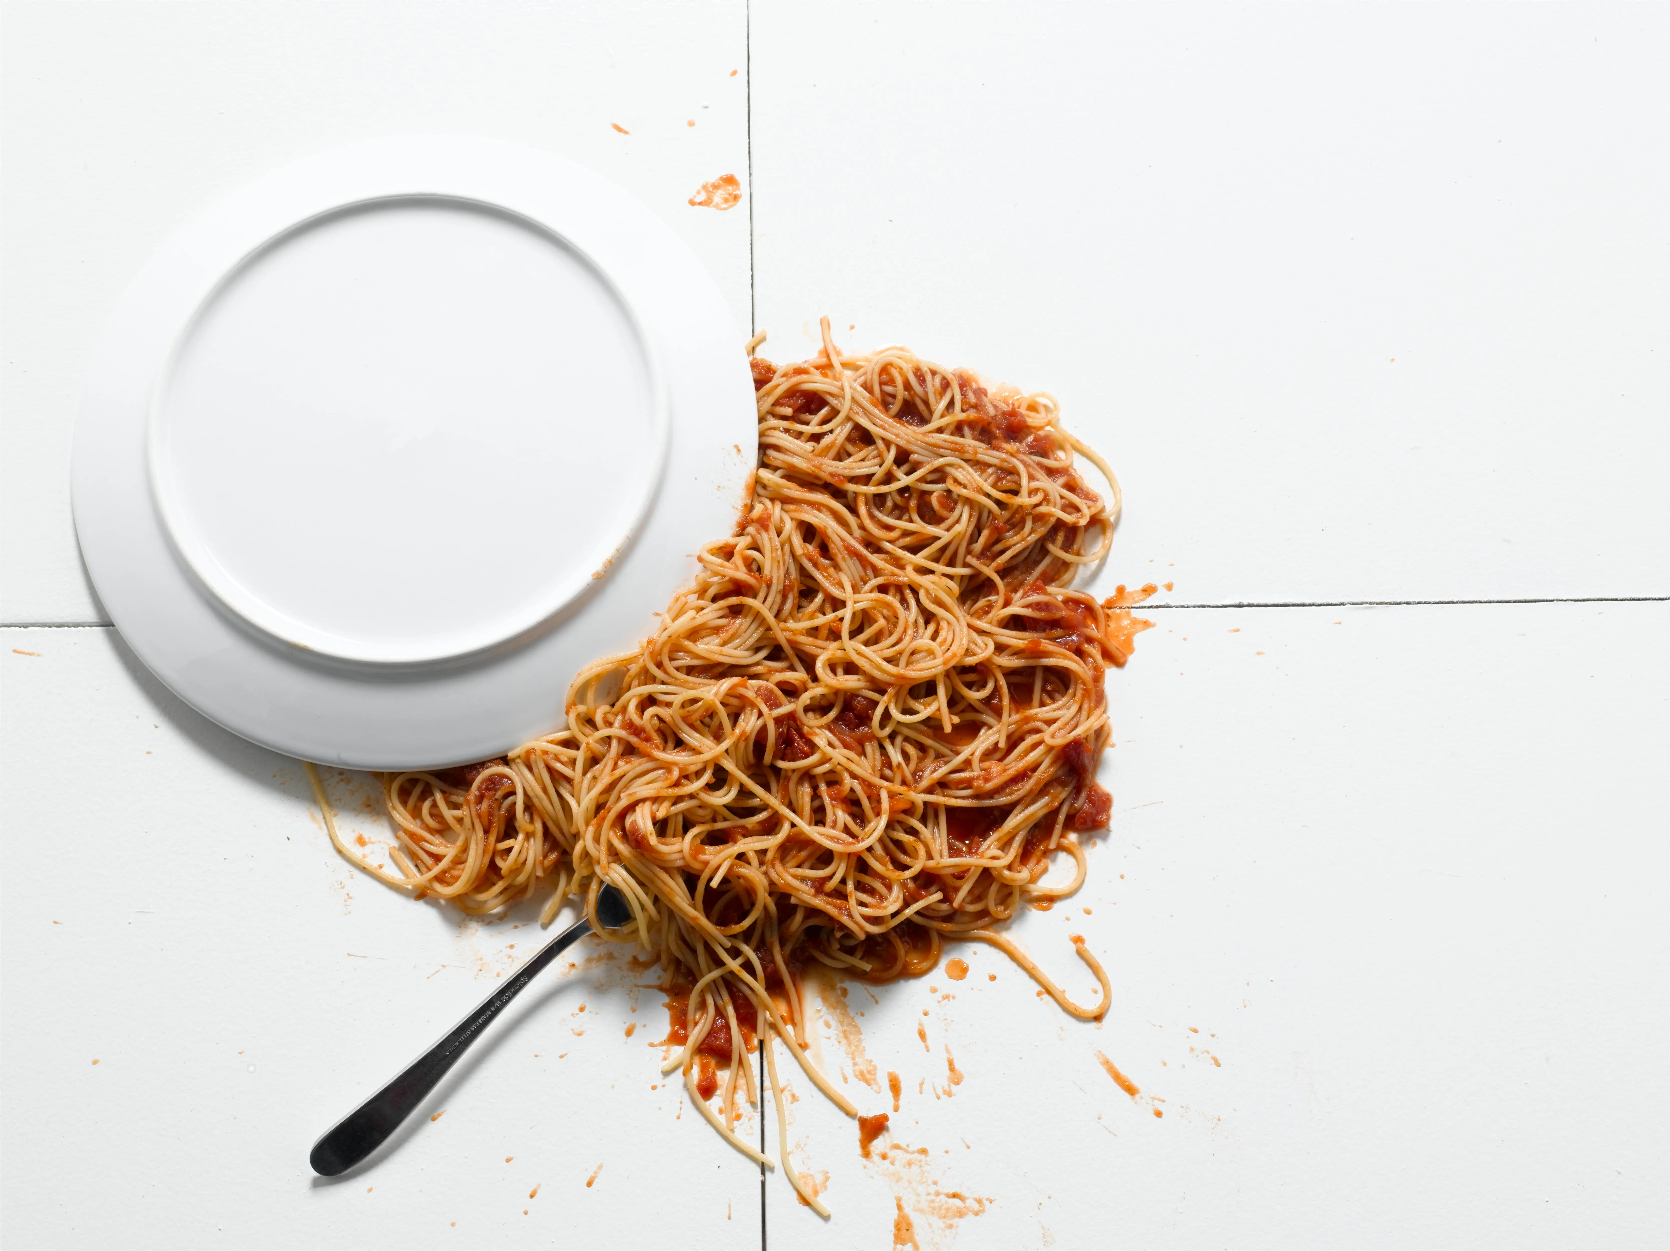
Accidents
Do not point out
Be discreet
Dropped food on you – wrap it
Be nice in all occasions
If something falls, put it under the table
If it is not possible, call a waiter; wait until crime scene is cleaned
No sneezing, burping

Slide 24
Activity!
situations
Notes:
Let’s talk about some rules
In some accasions
Business events
Politics
Ordinary people

Slide 25
Situation
Business event
Two men went to a business dinner. One of them is CEO of some IT company, second one is a specialist from other company. The CEO wants to hire the specialist to his own company.
1
Notes:
Two men went to a business dinner. One of them is CEO of some IT company, second one is a specialist from other company. The CEO wants to hire the specialist to his own company.

Slide 26
Situation
Visit from China
A guy wants to invite a random girl from central China to lunch at a restaurant in Brno. They have different requests for food. They're both formally dressed. The girl really liked the food.
2
Notes:
A guy wants to invite a random girl from central China to lunch at a restaurant in Brno. They have different requests for food. They're both formally dressed. The girl really liked the food.

Slide 27
Situation
Ball
Two couples meet at the ball. One couple is the company director and his wife and the other is his secretary and her husband. First they greet each other and introduce themselves, then they chat for a while and then go dancing.
3
Notes:
Two couples meet at the ball. One couple is the company director and his wife and the other is his secretary and her husband. First they greet each other and introduce themselves, then they chat for a while and then go dancing.

Slide 28
Situation
Banquet
You are members of the government and will attend a joint banquet. One of you is a waiter, who brings the courses one by one. But during the meal, a few accidents happen. The Minister of Transport will want to urinate, the Minister of Foreign Affairs will spill his wine and the Minister of Health will drop his steak on the floor.
4
Notes:
You are members of the government and will attend a joint banquet. One of you is a waiter, who brings the courses one by one. But during the meal, a few accidents happen. The Minister of Transport will want to urinate, the Minister of Foreign Affairs will spill his wine and the Minister of Health will drop his steak on the floor.
Cold Appetizer
Soup
Warm appetizer
Main dish
Warm dessert/cheese
Cold dessert
Fruit
caffe

Slide 29
Situation
Theater
Someone is a couple and goes to the theater. The rest of you play people in the theater and actors. You're sitting in the middle of the row, so you have to walk all the way down the aisle. There's a weird guy sitting two seats to the man's right. During the performance, the gentleman is going to have to go to the bathroom. Both of them will figure out that the performance sucks and they'll want to leave.
5
Notes:
Someone is a couple and goes to the theater. The rest of you play people in the theater and actors. You're sitting in the middle of the row, so you have to walk all the way down the aisle. There's a weird guy sitting two seats to the man's right. During the performance, the gentleman is going to have to go to the bathroom. Both of them will figure out that the performance sucks and they'll want to leave.

Slide 30
Sources
Wikipedia: https://cs.wikipedia.org/wiki/Etiketa
Ladislav Špaček’s Etiquette: https://www.ceskatelevize.cz/porady/1124997157-etiketa/
Notes:
Zdvořilé chování = polite bahaviour
Precedence = přednost [presidenc]

Slide 31

Thank you

